Slide 1
Use complex techniques to develop a digital media outcome your name

Slide 2
Step 1 : Empathize
The implications I will be focusing on are copyright, accessibility and aesthetics as I believe these are the most important parts of making an appealing website.

Slide 3
Task 1 : Identify your client and the purpose of your website, who is your target audience?
My client is the current OBHS Basketball coach Brent Matehaere.
The target audience will be anyone interested in the basketball team, either players or school pupils.
This means the target audience demographic will likely be teenagers who are at school.

Slide 4
Relevant Implication #1 – Copyright
Copyright is an important implication as all images and logos used on the site must be used with proper permissions to ensure that the site isn’t breaking any laws.
All images uses will be used with permission from their creators and won’t be modified unless permission to do so is given.
Notes:
Identify and explain 3 relevant implications that you will focus on during the creation of your project

Slide 5
Relevant Implication #2 - Accessibility
The site should be easily accessed by any device and any user at any time.
This is important to ensure that no matter what device is used to view the site it should still look appealing and function correctly. Furthermore, all browsers should be supported so that the site looks the same across each device.
Notes:
Identify and explain 3 relevant implications that you will focus on during the creation of your project

Slide 6
Relevant Implication #3 - Aesthetic
The website should look visually appealing with consistently styled elements and a theme that matches the clients logos.
The website should have a modern and appealing GUI with a vibrant color pallet that reflects the websites intentions.
The site should have a simple design and should not be difficult for users to look at or understand.
Notes:
Identify and explain 3 relevant implications that you will focus on during the creation of your project

Slide 7
What are your client’s specifications?
The site should contain information about the team and what they do.
The site should show the current team and their members
The website should show the teams schedule and current results for the season.

Slide 8
Client Specifications
sophisticated digital effects (CSS3)
responsive design (mobile vs tablet vs desktop)
industry standards or guidelines for layout/design
integration of original media types (your own photographs/ videos etc)
coded using HTML5/CSS3 language
4 html pages and with an externally linked style sheet / js file for responsive navigation

Slide 9
Current Browsing trends
50% of users use their mobile phone to access the internet while 46% use desktop and 4% use a tablet
The majority will be accessing the site using a mobile phone, 60% will be using Chrome while 25% will be on Safari.
Almost the same amount of people as mobile will be using a desktop computer – according to https://gs.statcounter.com/browser-market-share/desktop/worldwide around 70% will be using Chrome with both Safari and Firefox taking up 10%.
Some users may also be using a tablet with almost 50% of these using Safari as their primary browser while Chrome has a 35% user rate on tablet.
Therefore, both chrome and safari are the majority for browser usage with other browsers such as Firefox and Opera also seeing a small percent of usage.

Slide 10
Step 2 : Define

Slide 11
Website Structure
Website Site Map
index.html
interview.html
books.html
about.html

Slide 12
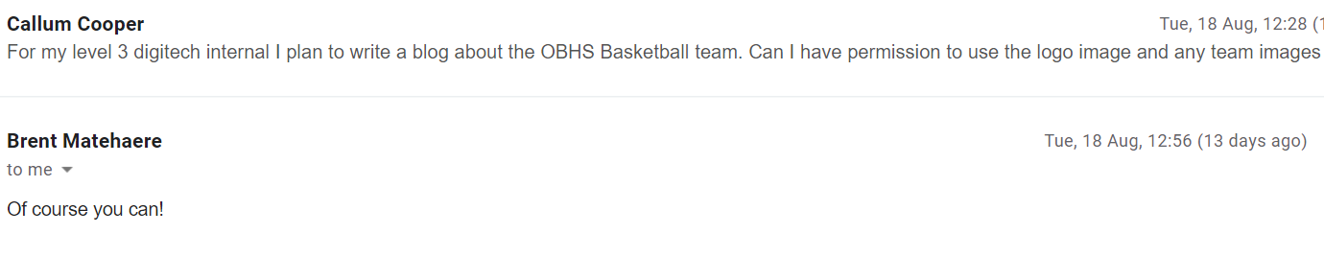
Evidence of written permission

Slide 13


Data Integrity Gather content – proofread and edit
Original
Edited
Added transparency and compressed file
Notes:
Data integrity is ensuring the information displayed is up to date , spelled correctly . Do F7 on your word content.
Testing

Slide 14
Gather Content
Notes:
Save images to an appropriate name folder
Compress / edit images where need be
Name the files accurately e.g home_mainimage.jpeg suzanne_collins_closeup.jpeg rather than 249784sflkjfnjksfxn3r8.jpeg
Record this process

Slide 15
Step 3 : Ideate

Slide 16
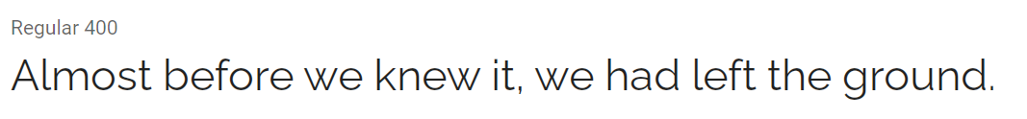
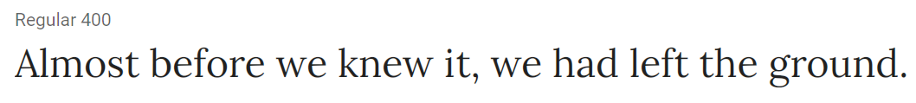
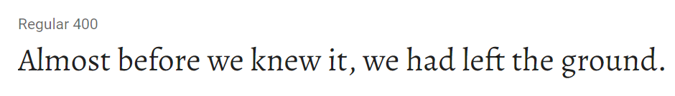
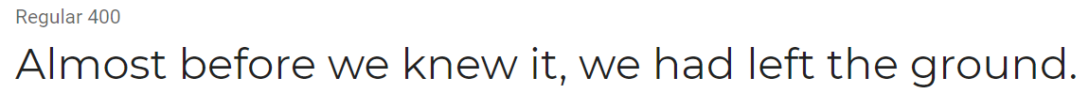
Font Combinations
https://fonts.google.com/specimen/Raleway
https://fonts.google.com/specimen/Montserrat
https://fonts.google.com/specimen/Lora
https://fonts.google.com/specimen/Alegreya
Feedback: 11111
Feedback: 1111

Slide 17
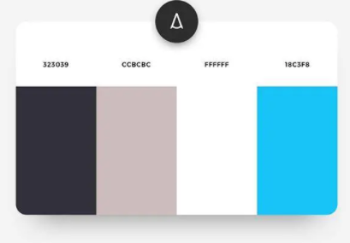
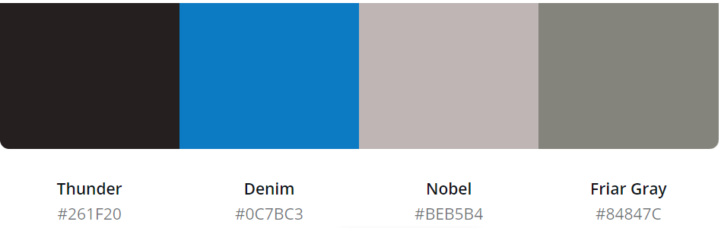
A vs B testing - colours
Feedback:111
Feedback: 111111
Notes:
Give two layout options for the index page – eg placement of cotent . Get feedback from client

Slide 18
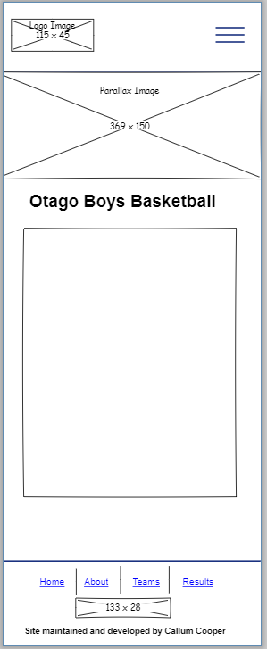
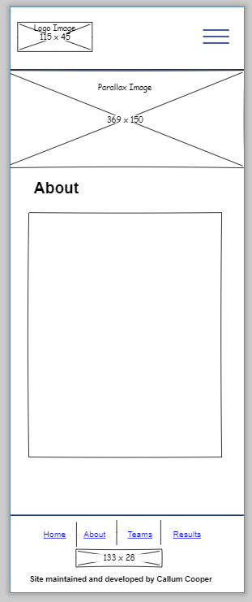
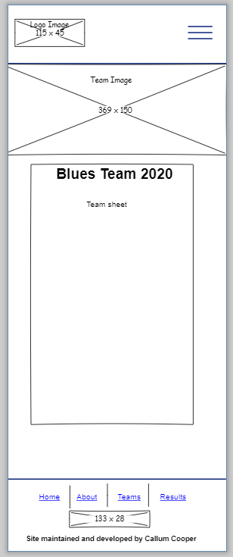
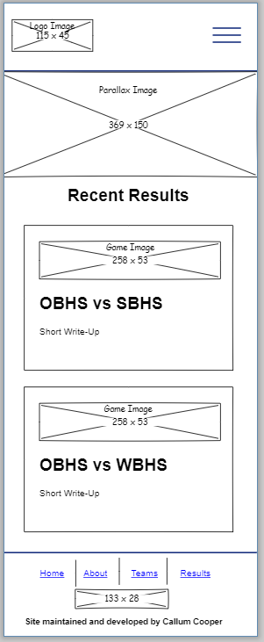
Low fidelity wireframes
Notes:
Use either

Slide 19
Feedback from client / stakeholders
Chosen fonts – Raleway + Montserrat
Chosen color -
Notes:
Get written feedback, then add your own reflections:
What changes do you need to make and why? Do you need to carry out further research or give more colour/font options etc/

Slide 20
Step 4 : Protype/ Testing

Slide 21
Site setup

Slide 22
Version Control
Version Control:
https://github.com/callumc20171/3.4-Assessment/commits/master

Slide 23
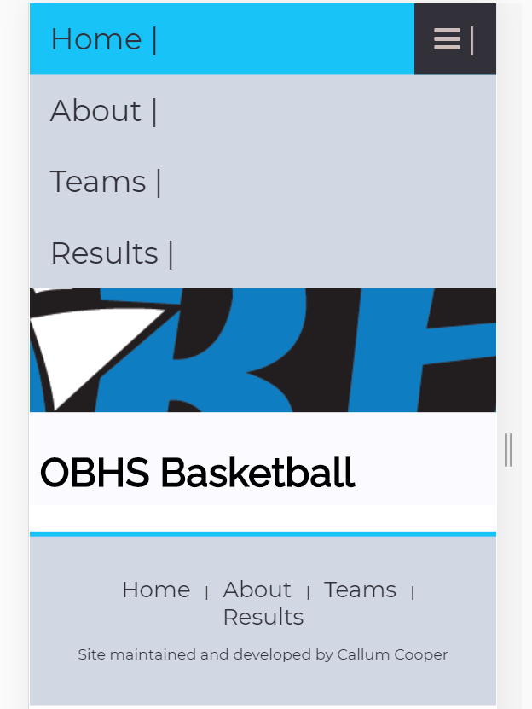
Day 1

Slide 24
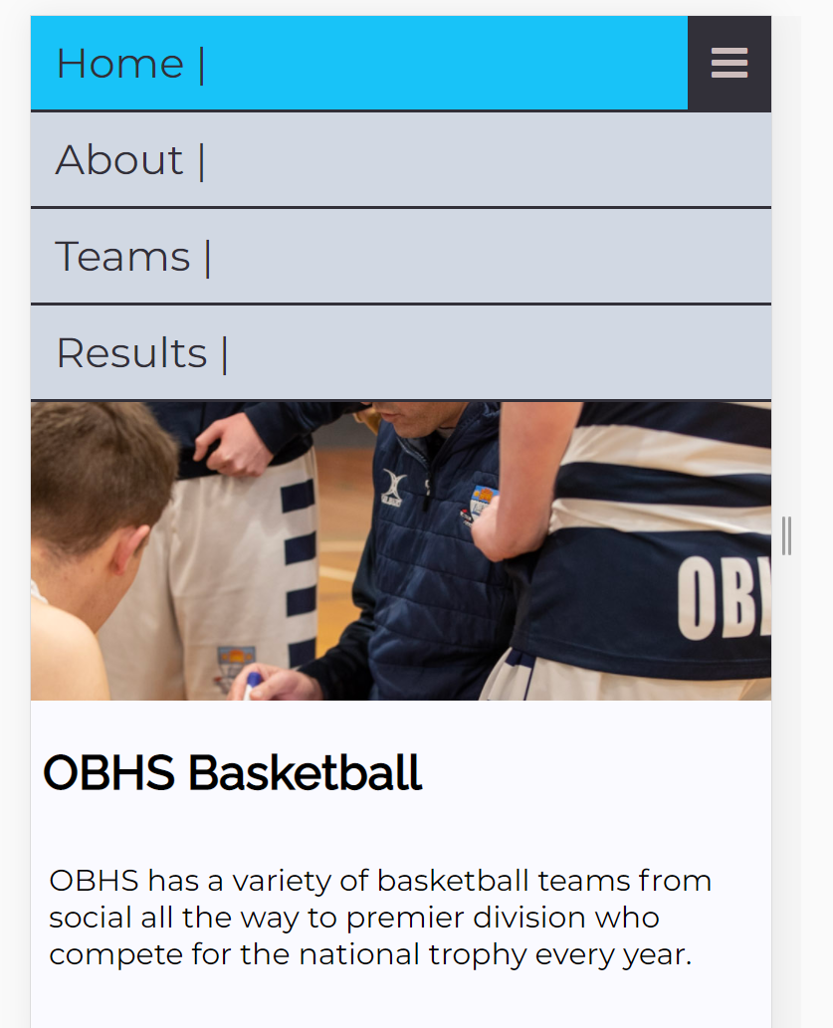
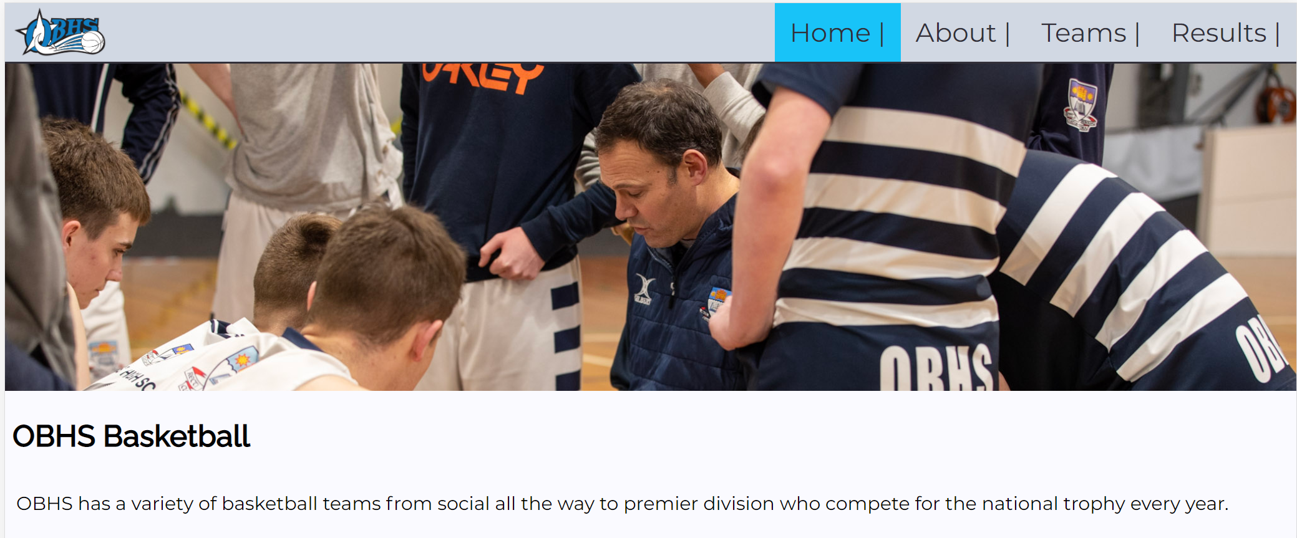
Day 2

Slide 25
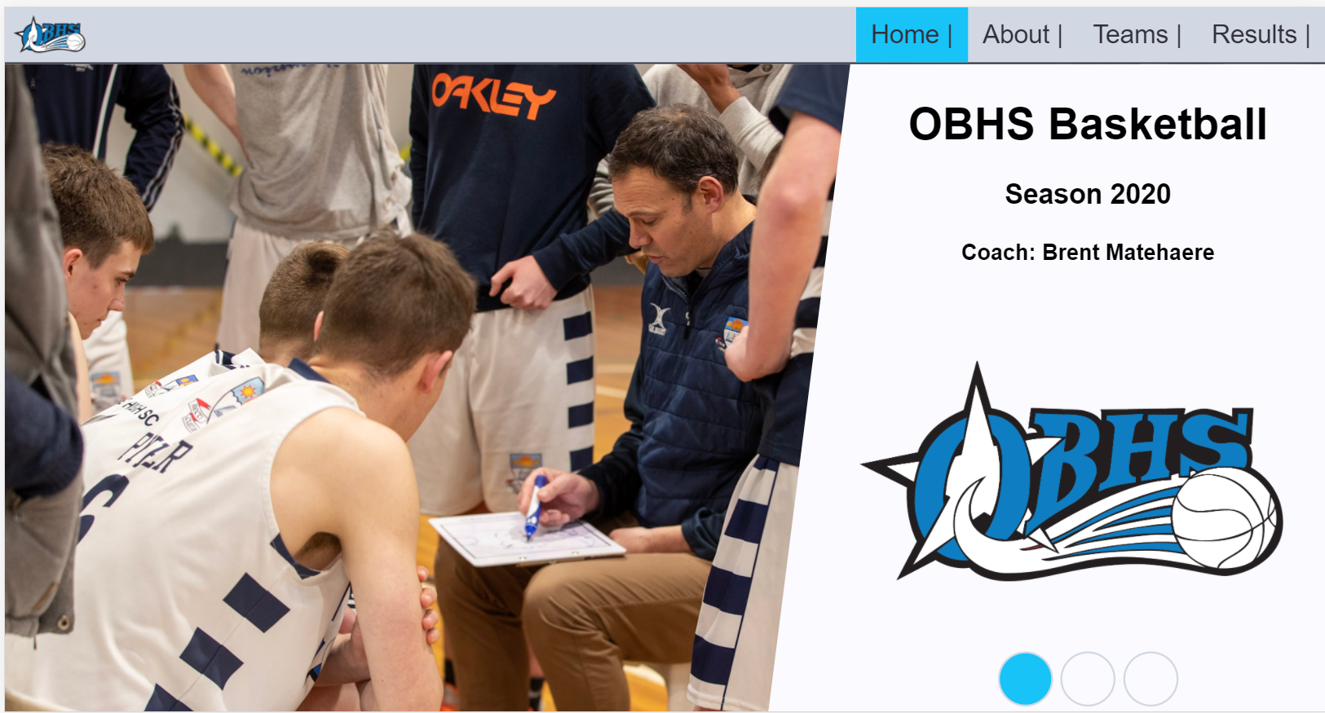
Day 3 – Redesigned home page for desktop

Slide 26
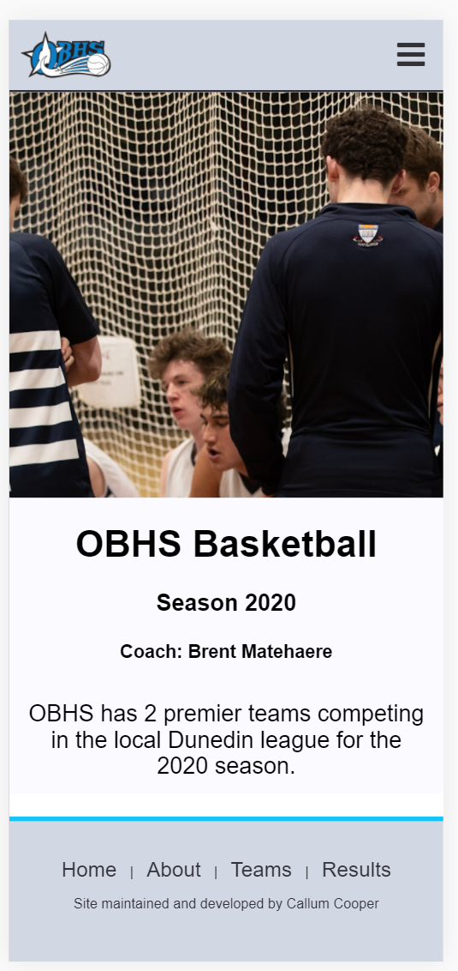
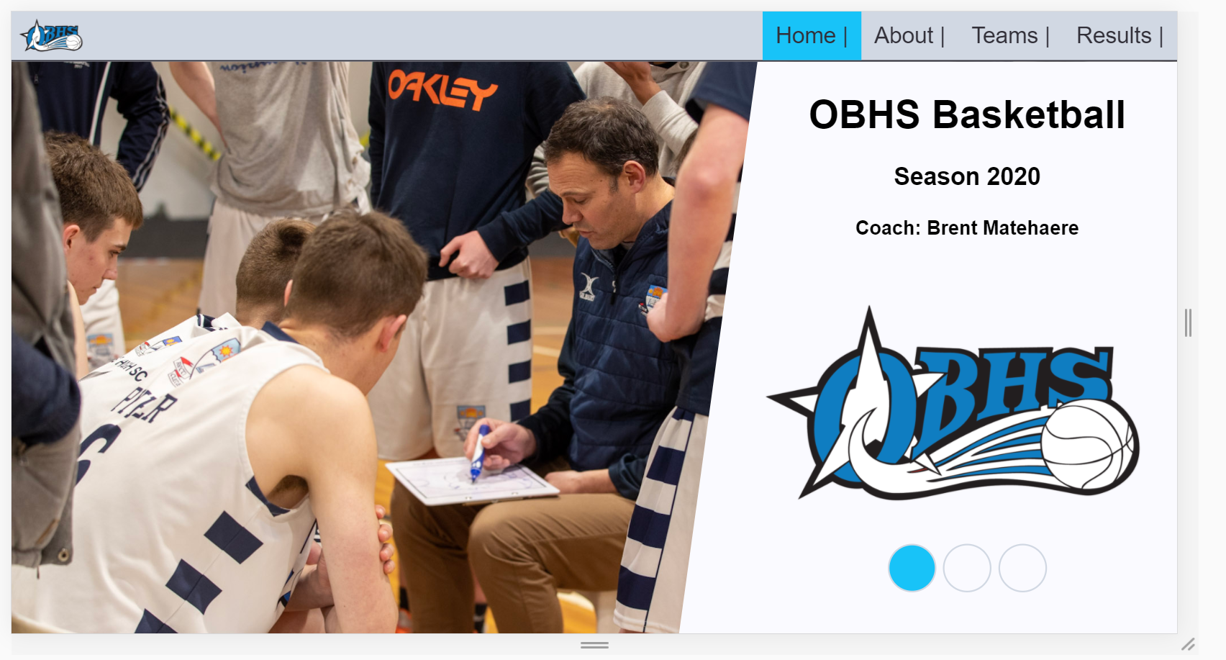
Day 4 – Adding mobile scaling to index page

Slide 27
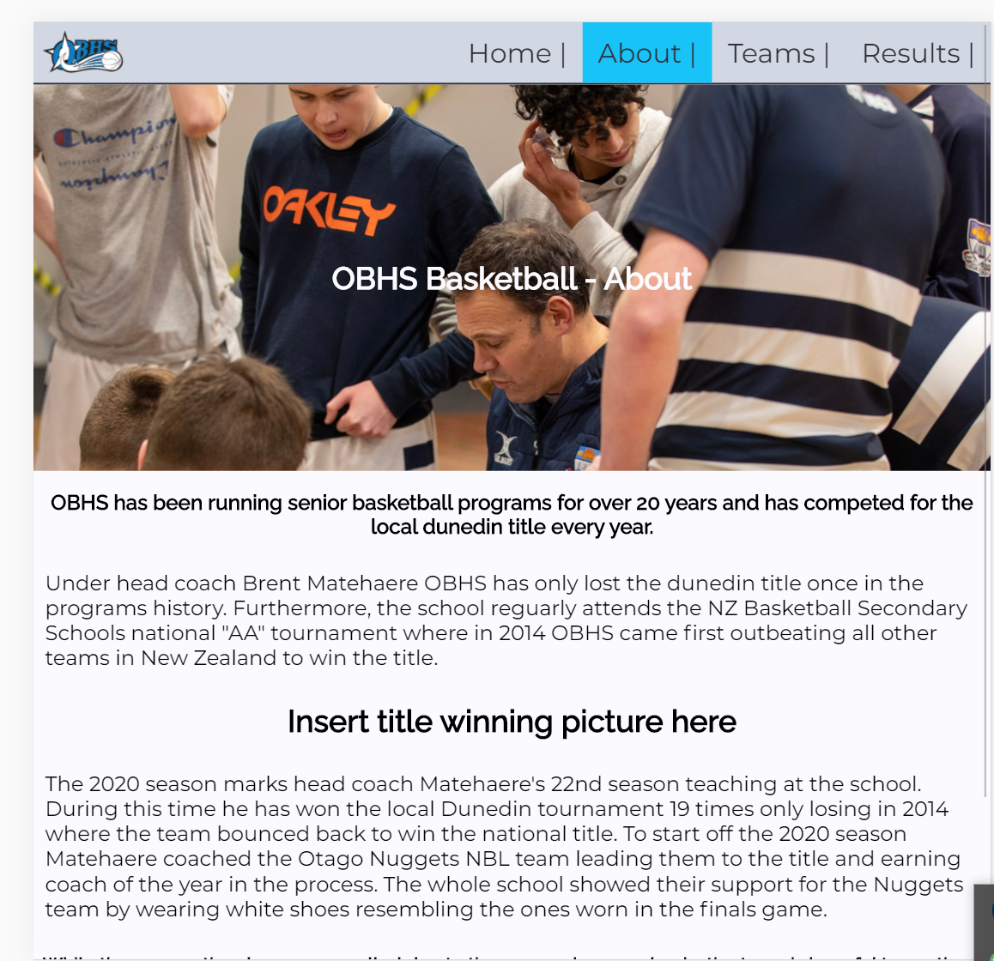
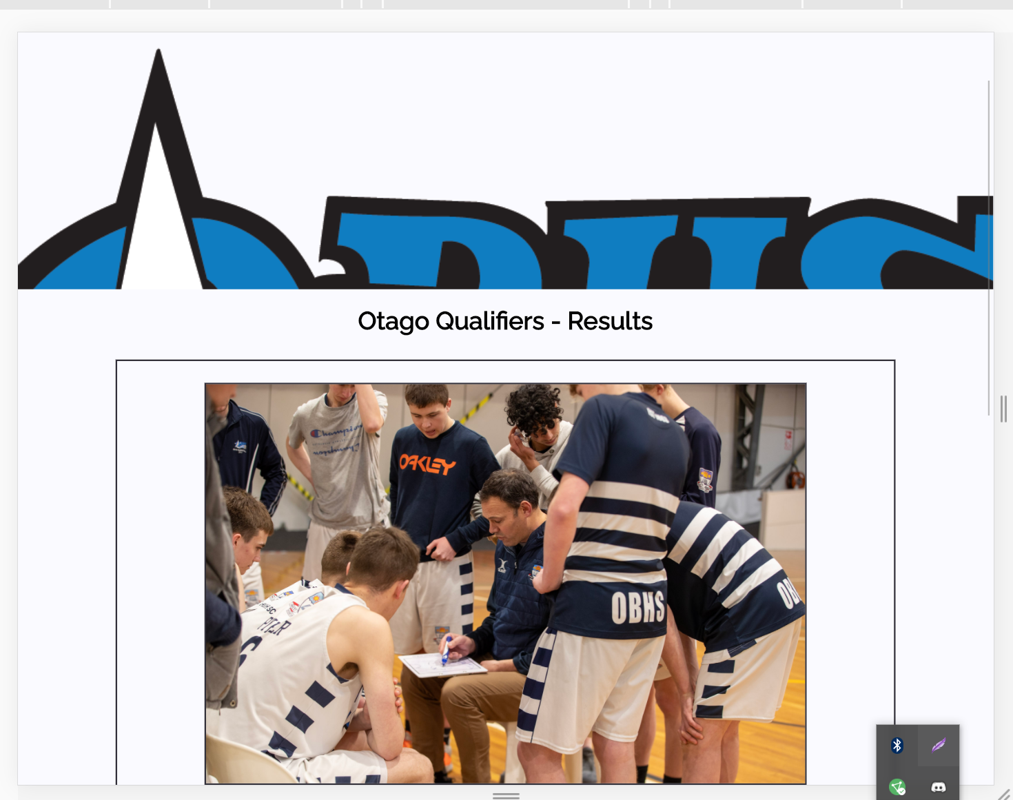
Day 5 – Start developing results and about page

Slide 28
Feedback
Add text to logo
Get rid of end vertical line on navbar - Done
Footer links bigger - Done

Slide 29
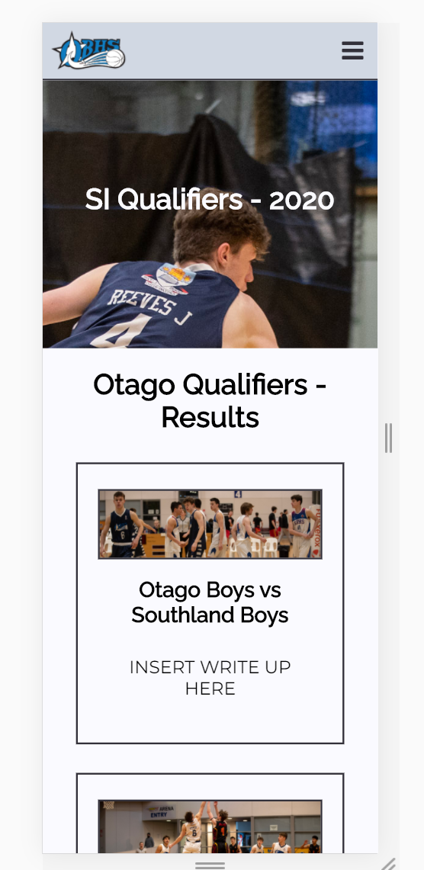
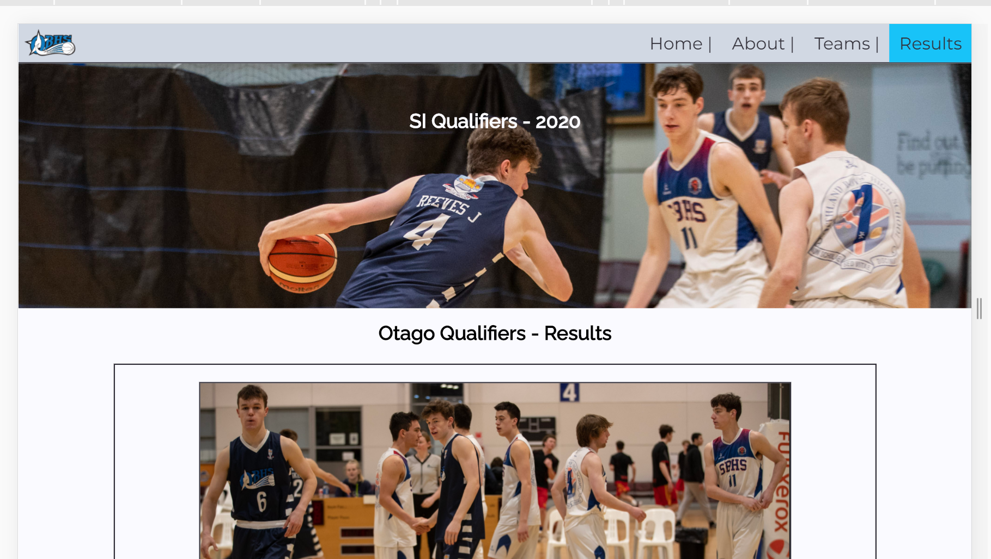
Day 6 – Updated pictures

Slide 30
Evidence of iterative improvement

Slide 31
Testing Scaling: Phone vs Tablet vs Desktop
Notes:
Test your site on mobile, tablet and pc view

Slide 32
Testing Procedures: Validating the HTML/CSS
Notes:
Validate your HTML/CSS3 website – screenshot the no errors.

Slide 33
Applying the UX (BASIC priniciples)to improve your design
Notes:
Identify which usability principles you have applied to improve the quality of your design – screenshot your design, place in your portfolio and annotate and explain how it improved the usability, aesthetics or functionality etc.

Slide 34
Explain how your final design addressed the relevant implications

Slide 35
Addressing relevant implication :

Slide 36
Addressing relevant implication :

Slide 37
Final website
Notes:
Create a video of your site in desktop view, slowly going through the content, scale it down to phone view too,. Insert the video above

Slide 38
Final feedback from client

